Slide 1
Computational Thinking
Shannon Haymond

Slide 2
Lesson Goals
Develop computational thinking skills to more effectively utilize emerging digital technologies
Lesson Objectives
Identify the key components of a complex problem and break it down into smaller, more manageable parts.
Use patterns to predict future outcomes or generalize solutions.
Create simplified models to represent complex systems.
Design step-by-step instructions or algorithms to solve a problem.
Describe basic coding concepts to better apply computational solutions.
Notes:
.

Slide 3
What is computational thinking?
Formulating things with enough clarity, and in a systematic enough way, that one can tell a computer how to do them
- Stephen Wolfram
We tell computers how via language
coding in programming language
using data scientist interpreter
low code/no code interface
Notes:
In the latter two you don’t need to know how to code, you need to understand computational thinking so you are more effective at delivering your message or ideas to those who will translate it to a programming language and determine how to get it done. Understanding computational thinking will likely also improve your attempts to learn a programming language.

Slide 4
computational thinking skills
Decomposition
Abstraction
Algorithm design
Pattern recognition
Evaluation & debugging
Notes:
In addition to these skills must have right attitude and behaviors
Attitudes
Confident: believing in one's own ability to solve problems
Communicative: willing and able to communicate effectively with others.
Flexible: able to deal with change and open-ended problems
Approaches
Tinkering: experimenting and playing
Creating: designing and making
Debugging: finding and fixing errors
Persevering: keeping going
Collaborating: working together.

Slide 5

decomposition
Decomposition
Break down a large, complex problem into smaller, more manageable parts to make it easier to understand and solve
Identify the main (large, complex) problem
Break it down into smaller tasks
Solve each sub-task
Combine solutions to solve main problem
Notes:
This is the process of breaking down a large, complex problem into smaller, more manageable parts. It is important because it makes the problem less overwhelming and easier to understand. Each smaller problem can be addressed individually, which is much more feasible than trying to solve the complex whole all at once.

Slide 6

Decomposing the act of Baking cupcakes
Planning & Preparation
01
Mixing
02
Baking
03
Finishing
04

Slide 7
Cupcakes: planning & preparation
Select the recipe
Gather ingredients
Collect kitchen supplies, tools, and equipment
Preheat the oven

Slide 8
Cupcakes: Mixing
Prepare dry ingredients
Prepare wet ingredients
Combine wet and dry ingredients
Notes:
Prepare dry ingredients: Measure and combine the flour, sugar, baking powder, and salt in one bowl.
Prepare wet ingredients: In another bowl, mix the eggs, milk, and oil.
Combine wet and dry: Gradually mix the wet ingredients into the dry ingredients, following the recipe's instructions for order and speed to prevent overmixing.

Slide 9
Cupcakes: Baking
Prepare the pan
Pour the batter
Bake for required time
Check for doneness
When done remove pan from oven

Slide 10
Cupcakes: finishing
Remove cupcakes from pan
Cool the cupcakes
Decorate cupcakes

Slide 11
Let’s try it

Slide 12




Today’s lab-related case
Exercise
Several individual files in a folder that you’d like to set up an automated data pipeline for and visualize in a dashboard

Slide 13
decomposition
Exercise
Join your classmates in small groups
Create list of sub-tasks for our dashboard job
For each sub-task start to define the inputs, outputs, and constraints
Consider how these will come together for a full solution
Share your ideas with the group

Slide 14
Examples of sub-tasks
Exercise
KPI selection (TAT, QC trends, volumes, ion ratios)
Data extraction (from files, LIS, middleware, EMR)
Data automation scheduling
Database set up or ingestion
Data cleaning/aggregation
Visualization choices (control charts, bar plots, table)
Dashboard platform (Power BI, R flexdashboard, Tableau)
Notes:
Define inputs (order/collect/receive/result times, assay_code, instrument_id, priority, location), transforms (compute TAT, standardize time, missingness policy), outputs (flags, summaries, alerts), and constraints. Getting this list right prevents scope creep.

Slide 15
How does this help us?
Anticipate necessary components, required expertise, data access, tools
Start to define user requirement and identify constraints and potential blockers
Helps clarify the job and makes it more manageable
Computational examples: writing code in chunks and splitting by task (reading data, graphing), distributed work of virtual machines, bioinformatic pipelines

Slide 16

Pattern recognition
Pattern recognition
Identify recurring patterns or trends within a problem to help formulate solutions
Look for common characteristics, motifs, and trends
Use pattern to identify solution
Generalize solution across pattern in sub-tasks but also in other problems
Notes:
After decomposing problems, the problem solver will look for patterns among the parts. Recognizing patterns helps in identifying similarities or trends that can inform the solution. This is important because it can lead to solutions that solve not just one specific instance of a problem, but a whole class of problems.
Look for motifs: weekday/weekend shifts, staffing transitions, maintenance windows. Feature ideas: rolling median, IQR, 95th percentile, slope, run length. Generalize by parameterizing thresholds—e.g., different SLAs for STAT vs routine. Beware Simpson’s paradox—always stratify.

Slide 17
Recognizing patterns in sub-tasks
We’ll need to gather ingredients, for each ingredient this involves:
Identifying (naming) the ingredient
Specifying the amount needed
Measuring the amount needed
We can then apply this method to each ingredient

Slide 18

Recognizing patterns across problems
Baking a cake vs cupcakes vs muffins
Select the recipe |  | Prepare the pan
Gather ingredients |  | Pour the batter
Collect kitchen supplies, tools, and equipment |  | Bake for required time
Preheat the oven |  | Check for doneness
Prepare dry ingredients |  | When done remove pan from oven
Prepare wet ingredients |  | Remove items from pan
Combine wet and dry ingredients |  | Cool items
 |  | Decorate items

Slide 19
Let’s try it

Slide 20
Pattern recognition
Exercise
Join your classmates in small groups
Select a sub-task from the prior exercise and list patterns you’d expect to find
Consider how these patterns may help you re-use a solution
Share your ideas with the group

Slide 21
Examples of pattern recognition
Exercise
Several metrics involve time intervals that require calculation
QC and TAT both use thresholds for performance
Many KPIs can be grouped into daily or monthly summaries
Monitoring same metrics for several assays or labs or techs

Slide 22
How does this help us?
Identifying similarities or trends can inform solution that may be generalized to solve classes of problems vs single
Addressing patterns with a shared solution ensures consistency and scalability
Improve persistence and efficiency when faced with solving new problems
Computational examples: solving optimization problems using gradient descent, applying loops to iterate over items
Notes:
Once you design a script or dashboard element that calculates duration between two timestamps, you can apply it across all time-based KPIs.

Slide 23

abstraction
Abstraction
Focus on the essential details and ignore the irrelevant information to create a generalized understanding of the problem and solution.
Identify essential information needed to solve the problem
Filter unnecessary details
Form a model that will be used to solve problem
Notes:
This involves filtering out the unnecessary details and focusing on what’s important. Abstraction is important to the computational thinking process because it allows problem solvers to disregard the irrelevant and complex details that can clutter the thought process, thus simplifying the problem-solving steps. It helps define the problem without getting sidetracked by details that do not affect the outcome.
Keep the dataset minimal but sufficient. Define entities (specimen, order, instrument-day), keys (specimen_id, instrument_id, location, day), and policies (units, time zones, missingness, handling canceled orders). Add fields only if they change decisions.
This schema is enough to compute TAT, stratify by context, and trend: specimen_id, order/collect/receive/result_time, assay_code, instrument_id, priority, patient_location, and derived tat_minutes. Extend later with batch_id or maintenance flags as needed.

Slide 24
Abstracting the science of baking
Instead of thinking about the details of the chemistry of cooking or the physics and mechanics of the oven’s operations, we follow a recipe and operate the oven’s controls

Slide 25
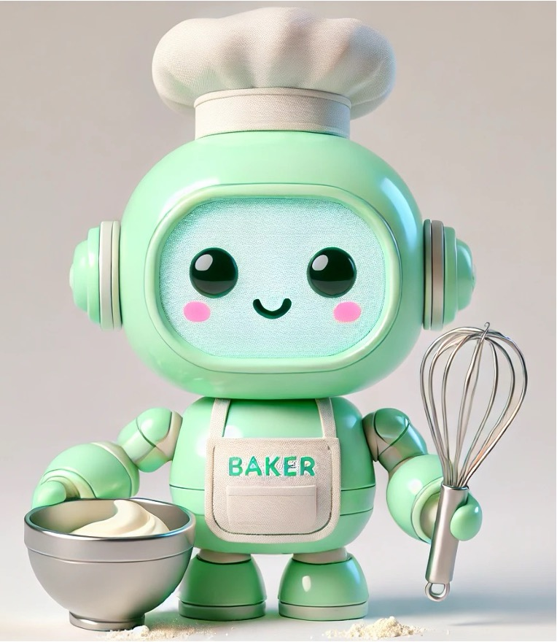
Basic Recipe: a model for baking
Select the recipe |  | Prepare the pan
Gather ingredients |  | Add item to pan
Collect kitchen supplies, tools, and equipment |  | Bake for required time
Preheat the oven |  | Check for doneness
Prepare ingredients |  | When done remove pan from oven
Combine ingredients |  | Prepare item for serving
We can filter out many of the specifics: what item, what ingredients, how much, how long, what temp, what flavor, what color frosting, etc.

Slide 26
Let’s try it

Slide 27
abstraction
Exercise
Join your classmates in small groups
Select a visualization from your hypothetical dashboard.
Define the essential data and elements you need for an effective visualization. What is your model?
Share your ideas with the group
Notes:
Imagine you’re presenting TAT performance to your hospital’s Quality Committee. You have only one chart. Which essential data elements should be included so the committee can immediately see if you are meeting goals, spot concerning trends, and take action? What details can you safely leave out?

Slide 28
Examples of abstraction
Exercise
Decide chart type or table, axes, labels, encoding elements
Define which data elements (timepoints, analytes, peak type), units, thresholds
Select key tests and areas/services to monitor
Decide which visualization tool to use

Slide 29
How does this help us?
Simplifies the situation to help focus on most important aspects, highlights similarities, and makes actions efficient and easier to perform
Already seen examples of how this can make decision making easier in data visualization context
Computational examples: APIs, programming functions, LLM chat interfaces, business intelligence tools

Slide 30

Algorithm Design
Algorithm design
Develop clear, step-by-step instructions or plans for how to solve a problem, which can then be executed by a human or computer.
Define starting point (input) and ending point (output) with sequential steps in between
Represent with words/pseudocode/code or flow diagram
Notes:
The final component of computational thinking is about creating a clear, ordered series of instructions to solve a problem. This is important because having a well-defined set of steps ensures that the problem can be solved systematically and that the solution is repeatable. It also allows for the solution to be communicated to others easily—or even be automated.

Slide 31
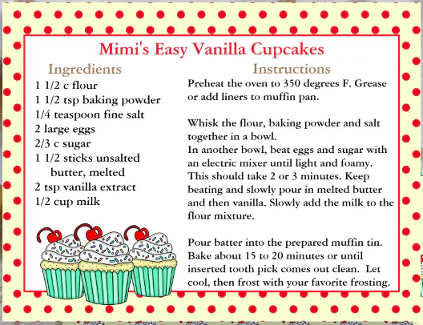
Detailed recipe: algorithm for baking

Slide 32
Let’s try it

Slide 33
Algorithm design
Exercise
Join your classmates in small groups
Using the visual from the previous exercise, write out a flow diagram to create it.
You can be sharing the instructions with a data scientist or with an LLM chat interface.
Share your ideas with the group

Slide 34
Examples of algorithm design
Exercise
Read data: which data to use
Prepare data: how filter, treat missing, treat outliers, calculations, how join
Select visual: table vs chart, what metric, what threshold, color, size, shape, titles, labels
Create visual: how to render
Notes:
Decide pre-checks (columns present, non-negative durations, monotonic times). Compute TAT and robust baselines by stratum (assay, priority, location). Flag outliers (e.g., median + 3×IQR or SLA threshold). Aggregate to daily rates and route alerts. Log lineage for reproducibility.
How CT guides node-based workflows: make each node a decomposed step; label inputs/outputs; version & export.
Reproducibility: parameterize thresholds, save configs, log data versions.
Validation: unit-like checks (expected rows/columns, % missing), golden test cases.
Governance: avoid black boxes; document assumptions; capture lineage.

Slide 35
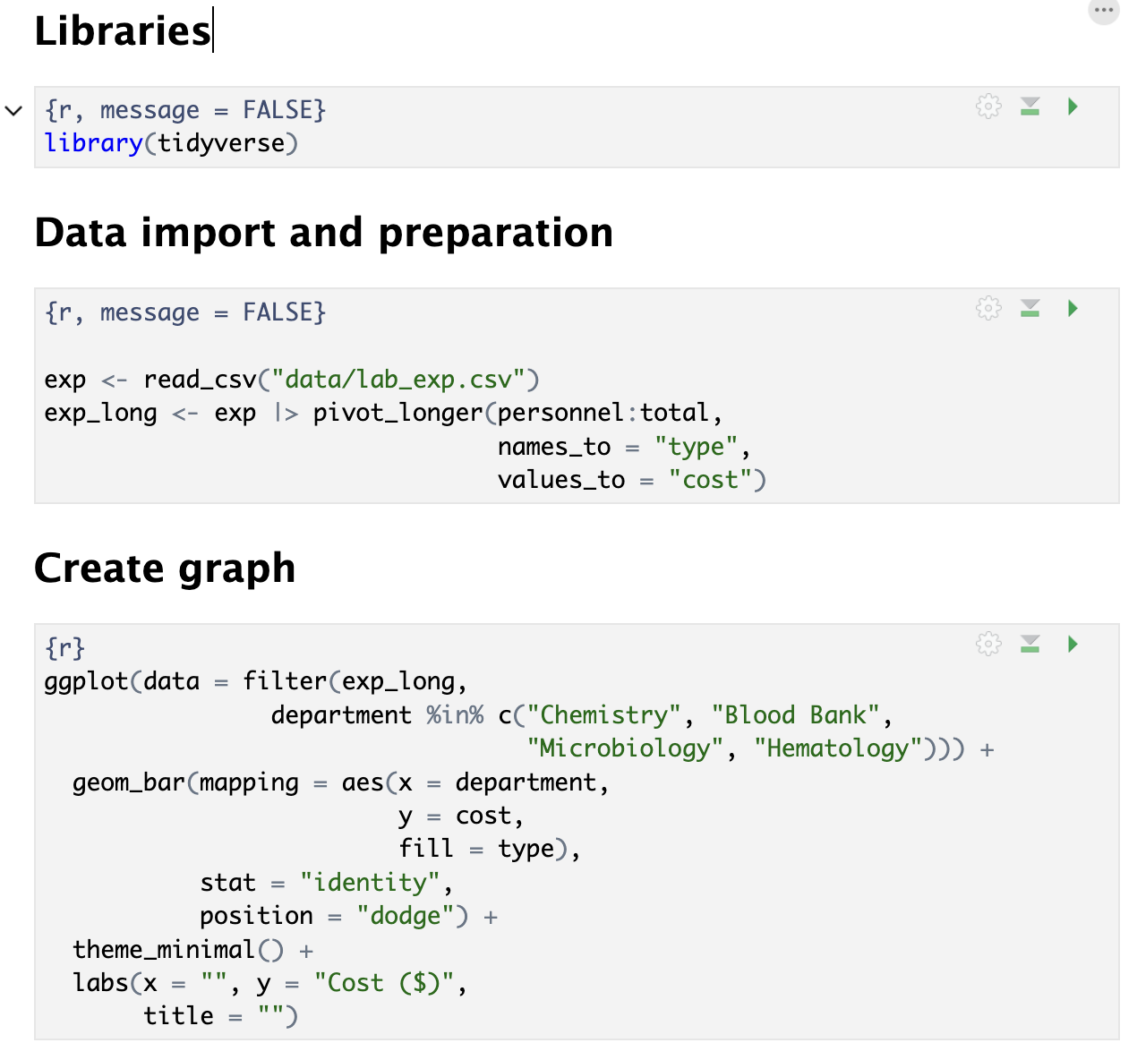
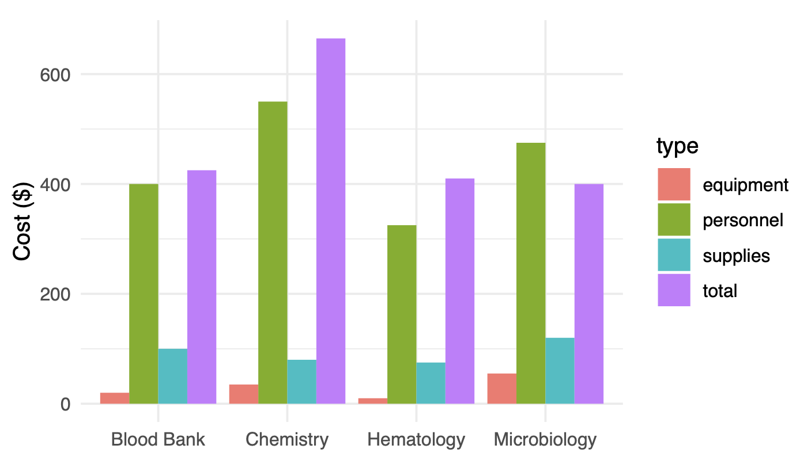
Algorithm design for graphing in R

Slide 36
How does this help us?
Designing an algorithm helps understand the problem and often means the solution is generalizable
Strengthens critical thinking and problem-solving skills
Makes output predictable and reliable
Computational examples: computer code, machine learning

Slide 37

Evaluation & debugging
Assess whether solution does the job it has been designed to do, fix errors, and consider improvements
Evaluate the solution, check correctness + usefulness
Debug it, find and fix errors with test cases
Expect iteration to refine correctness and efficiency
Notes:
is easily understood – is it fully decomposed?
is complete – does it solve every aspect of the problem?
is efficient – does it solve the problem, making best use of the available resources (eg as quickly as possible/using least space)?
meets any design criteria we have been given

Slide 38
How does this help us?
Builds confidence in results
Ensures solution is useful and will be effective
Develops problem-solving skills through systematic analysis
Increases adaptability as more comfortable experimenting, testing, and iterating

Slide 39
Building a foundation for ds101
The computational thinking skills we’ve learned so far relate directly to basic programming concepts
Computational thinking skill | Programming concept
Abstraction steps identify essential elements that are re-used | Function
Abstraction and algorithm design identify rules or decisions that guide actions | Conditional
Pattern recognition and algorithm design identify repeated steps | Loop

Slide 40
Basic computational concepts
Concept Description
Function Set of commands to generate outputs from inputs
Conditional Change action based on specific conditions
Loop Run the same command(s) repeatedly
Notes:
Commands and Sequences is to give students an appreciation of the level of detail and rigor that programming requires. In everyday life, we do things without thinking about all the steps we need to take to accomplish them, but it is not easy to make the steps of some simple operations clear to other people or objects (such as computers).
The Thinking Efficiently - Functions and For Loops topic is designed to give students an understanding how functions and for loops are used in everyday situations and how to use them to program problems. The Thinking Repeatedly - while loops and algorithms topic is for students to understand the difference between while loops and for loops and how algorithms are used in everyday situations. The final challenge competition is to integrate program fragments and present them in the form of a work to achieve the purpose of learning to use.
following seven computational concepts, ordered in increasing
difficulty: Basic directions and sequences; Loops–
repeat times; Loops–repeat until; If–simple
conditional; If/else–complex conditional; While
conditional; Simple functions.

Slide 41
What is a function?
Computational method for performing a specified task you will use repeatedly
Takes inputs (arguments) and generates outputs
May be custom or pre-built within a tool
Ensures consistency and efficiency
Packaged into packages (R) or libraries (python) in coding languages
Excel formulas: manually enter or use existing (e.g., AVERAGE() )
R functions: create your own or use from packages (e.g., ggplot())

Slide 42
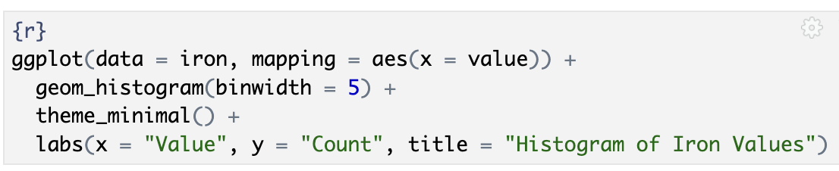
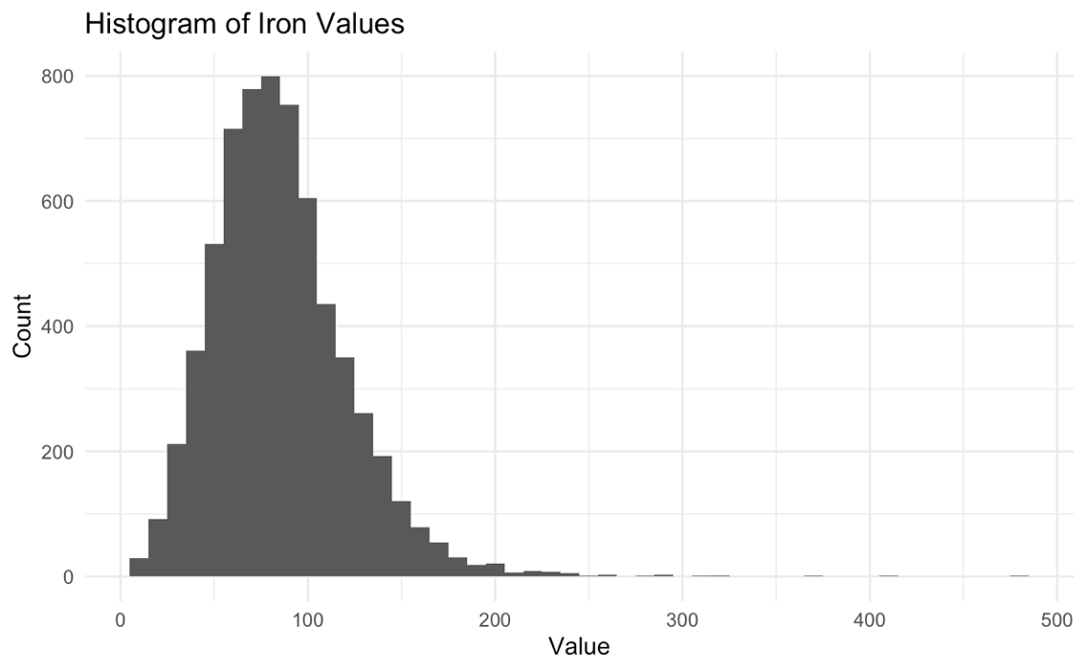
Ggplot R function creates a new graph object
function inputs (aka arguments)
function name
function output

Slide 43
What is a condition?
Algorithms frequently include decision points with different actions taken based on decision result
Use conditionals to apply functions appropriately given situation, whether statements are true or false
If, else if, and else are very commonly used examples
When selecting a pan:
If baking cupcakes, use cupcake tin
If not cupcakes, but is (else if) a cake, use round cake pan,
Otherwise (else), use square pan

Slide 44
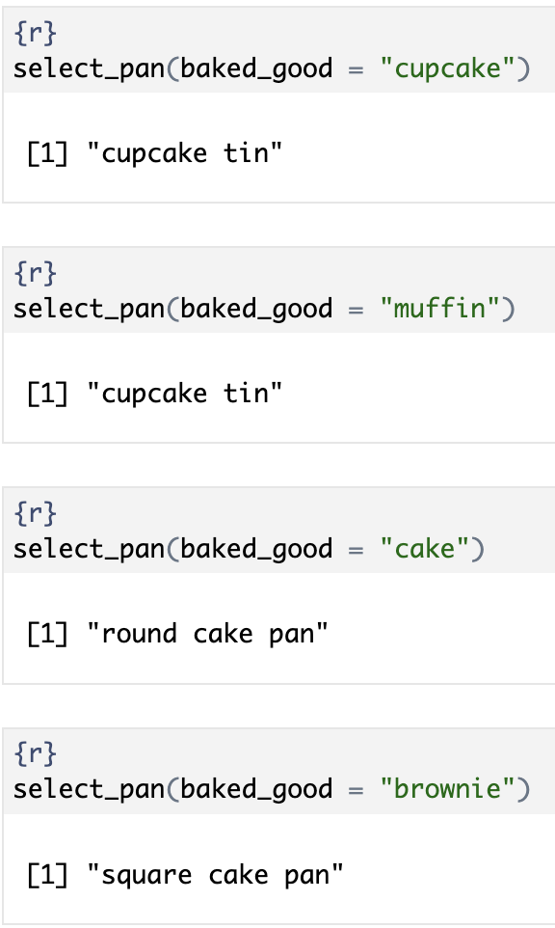
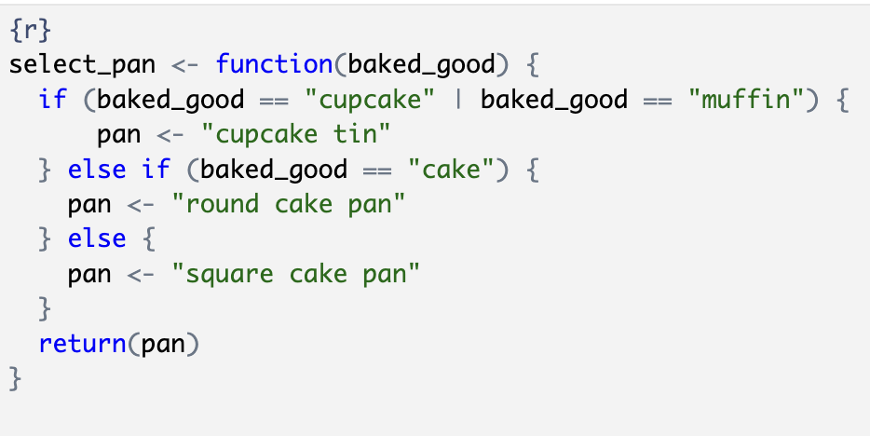
Combining functions with conditionals
Write the function to provide different outputs based on inputs and conditions
1. Write the function (be sure to test it) and save
2. Use the function: provide input and get output
input
output
conditions

Slide 45
What is a loop?
Coding process that executes a specific instruction (block of code) repeatedly until a condition is met
Common conditions describe the type of loop:
For loop: repeat a specified number of times
For each loop: Iterate over specified items without knowing index
While loop: continue if a condition is true

Slide 46
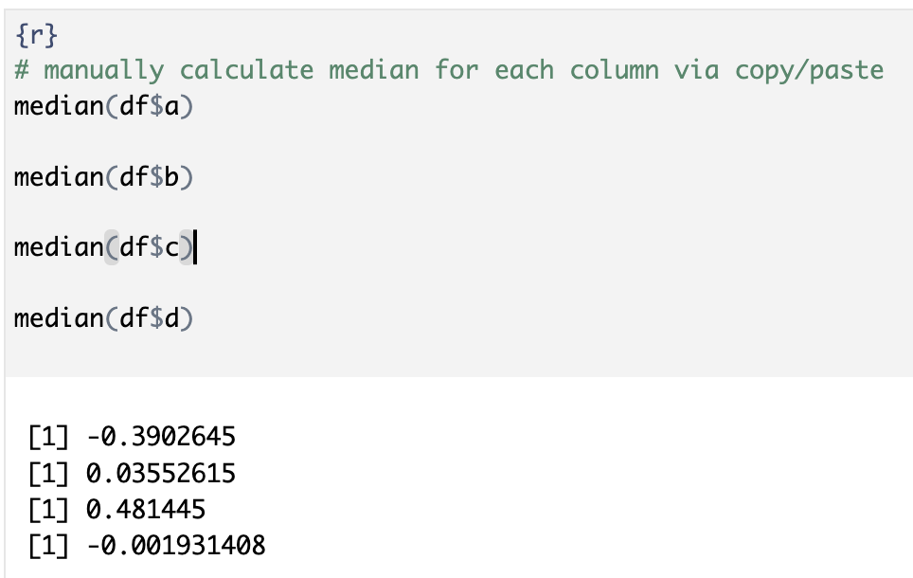
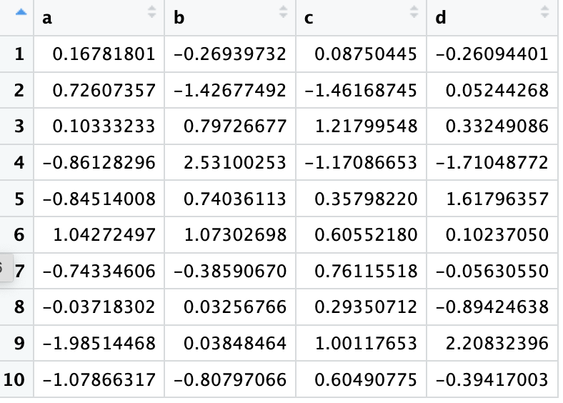
Calculate the median for each column: Copy and paste method
Notes:
How would you do this in Excel – copy and paste formula

Slide 47
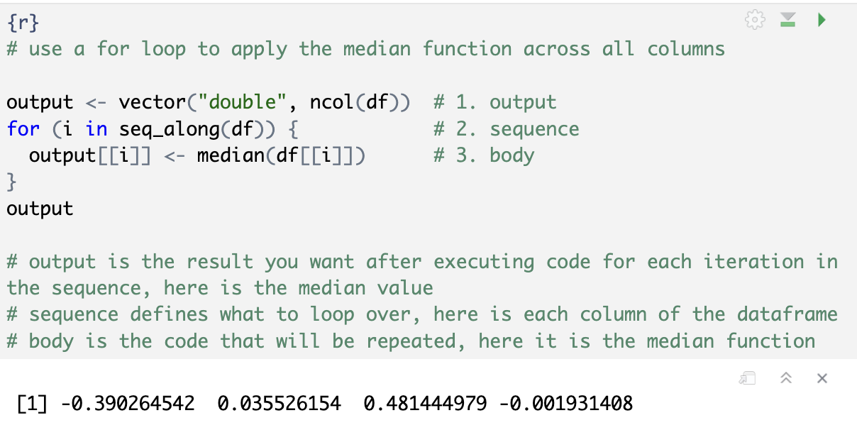
Calculate the median for each column: for loop method

Slide 48
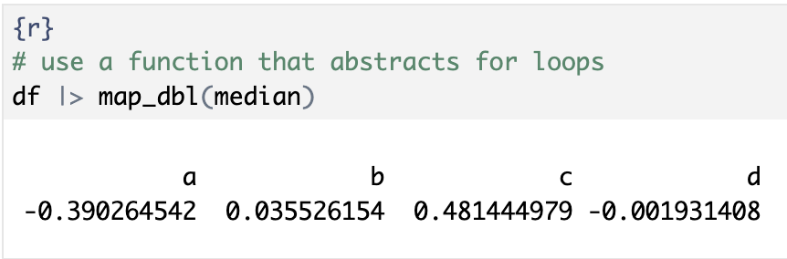
Calculate the median for each column: for loop method

Slide 49
What is computational thinking?
Formulating things with enough clarity, and in a systematic enough way, that one can tell a computer how to do them
- Stephen Wolfram
We tell computers how via language
coding in programming language
using data scientist interpreter
low code/no code interface
Notes:
In the latter two you don’t need to know how to code, you need to understand computational thinking so you are more effective at delivering your message or ideas to those who will translate it to a programming language and determine how to get it done. Understanding computational thinking will likely also improve your attempts to learn a programming language.

Slide 50

GPT (GPT-4o, GPT-4.5)
Reasoning (o4, GPT-5)
Like a junior co-worker
Will perform best with explicit instructions and examples for a specific output
Like a senior co-worker
You can give them a goal to achieve and trust them to work out the details
Given these differences, we may need to prompt them differently
https://platform.openai.com/docs/guides/reasoning-best-practices
Notes:
Reasoning models think through problems, connect ideas, and make a logical decision based on its information and the context you provide.
Generally speaking, they’re useful for tasks that require:
Deep problem-solving (e.g. calculating a math problem)
Logical reasoning (e.g. optimizing and debugging code)
Multi-step thinking (e.g. developing a strategy)
Non-reasoning GPT models focus on providing a quick, simple response. They rely on patterns in data, but they don’t analyze deeply or reason through problems.
Some tasks they’re useful for are:
Fast responses (e.g. addressing a question to customer support)
Simple tasks (e.g. creating the answer to a frequently asked question)
Creative content (e.g. writing straightforward marketing copy)

Slide 51
Prompting methods
One-Shot Prompt
Provides the data and asks directly for desired output
Relies on the model's existing knowledge of the subject
More concise but may produce less consistent results in some models: best for reasoning models and less reliable for GPT models
Few-Shot Prompt
Shows examples of the desired input-output pattern
Provides context for output
More likely to produce consistent, well-formatted results
May work best with GPT models
Notes:
Also mention chain of thought
Shannon

Slide 52
ONE SHOT Prompting example
You are a laboratory director analyzing fasting glucose results from 300 adult male and female patients collected at multiple hospital locations. Create a visualization (such as a boxplot or violin plot) of the fasting_glucose_dataset.csv that compares fasting glucose distributions across locations and highlights any significant insights or differences. Provide R code and also a plain-English interpretation of what the graph might reveal.

Slide 53
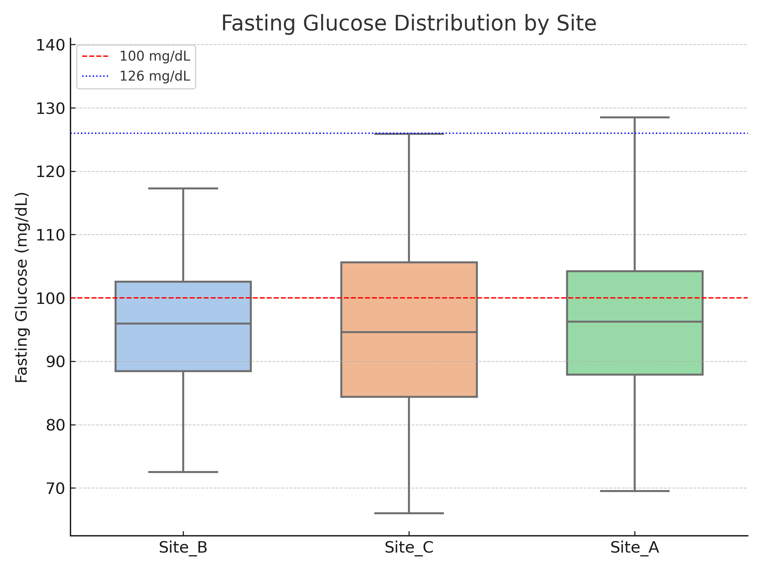
Chatgpt5 output
Expect visibly different distributions across sites. In the dataset I generated, Site_B tends to show a slightly higher median and a wider spread than Site_A and Site_C, with more values above 126 mg/dL (the dotted line) and a higher share in the 100–125 mg/dL range (dashed to dotted line).
Site_A and Site_C typically look more similar, with tighter IQRs and fewer high outliers.
If the Kruskal–Wallis test reports a significant p-value (and pairwise Wilcoxon tests confirm Site_B > others), that supports a site effect. Practically, that could prompt a pre-analytical/process review at the higher-median site (e.g., fasting adherence, draw timing, tube handling, transport time/temperature, centrifugation delays).
In the sex-stratified view, you may see small, not dramatic differences between males and females; the main pattern remains the site-level shift.
Where are the jittered points shown in code provided?

Slide 54
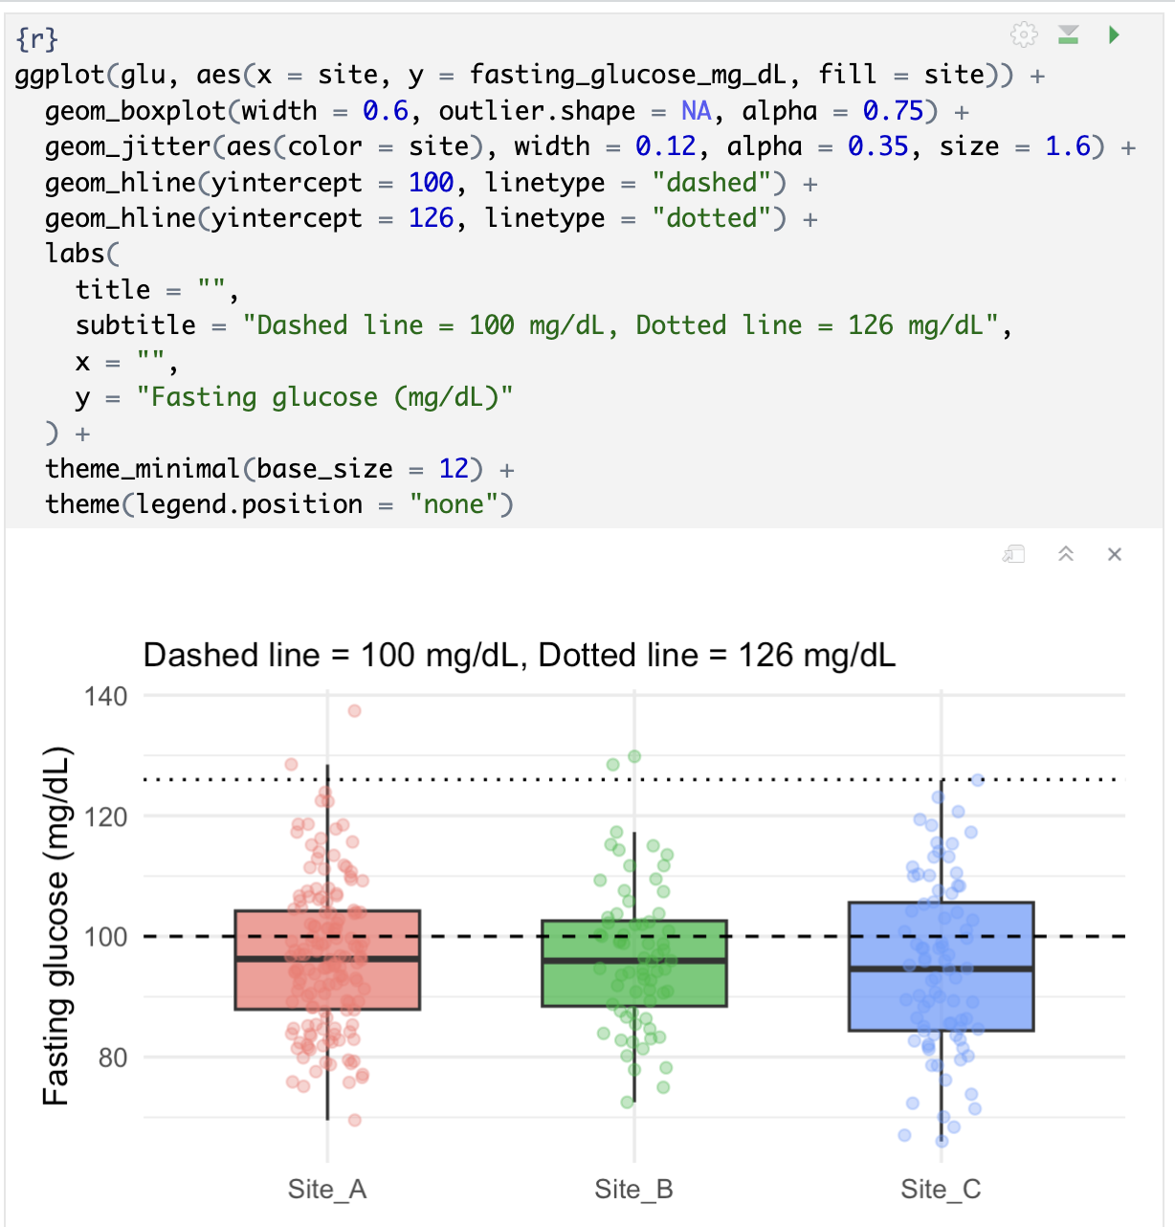
Let me check your work, You need to try again
SECOND TRY:
Interpretation (plain English):
All three sites have very similar fasting glucose distributions, with means around 95–97 mg/dL.
Roughly one-third of patients at each site fall in the impaired fasting glucose range (100–125 mg/dL).
Very few patients exceed the 126 mg/dL diabetes threshold (1–3%).
The Kruskal–Wallis test confirms there’s no statistically meaningful difference among the sites.
This suggests that any site-to-site variation in the dataset is minor and likely due to chance, not systematic issues in specimen handling or processing.
96.25
95.95
94.60

Slide 55
Few shot prompting example
Aiming to train the model using examples of different types of visualizations, the model sees a broader pattern of reasoning vs learning a template for a specific type of model
Identify the analytical question → choose an appropriate chart → generate code → interpret results

Slide 56
Few shot prompting example
Example 1: Data: Potassium measurements from 200 patients across 4 locations. Task: Create side-by-side boxplots comparing locations. Expected Output: R code for ggplot, and a short interpretation noting if any site shows higher variability suggesting sample hemolysis.
Example 2: Data: Troponin I QC results at 2 levels over 20 days. Task: Generate a Levey-Jennings plot with Westgard rule violations highlighted. Expected Output: R code and a short interpretation of QC stability.
Now apply the same approach to this real case: Data: Use the provided CSV that contains fasting glucose results from 300 adult male and female patients collected at multiple hospital locations. Task: Create a visualization (boxplot or violin plot) comparing fasting glucose distributions across locations and highlights any significant insights or differences. Expected output: visualization, R code, and a short interpretation of distributions across sites.

Slide 57
Future: Make it the best around
Appropriate model selection
Not all models are great at all tasks, tradeoffs and practical reasons
General purpose or reasoning; what vendor (Google, OpenAI, Microsoft, Meta, Anthropic)
Get more from general LLMs
Customization
Prompt engineering
RAG and fine-tuning approaches
Data quality
Ensuring high-quality input data is crucial for accurate visualizations
Preprocessing and cleaning data can help mitigate this issue
Notes:
Shannon

Slide 58
Lesson Goals
Develop computational thinking skills to more effectively utilize emerging digital technologies
Lesson Objectives
Identify the key components of a complex problem and break it down into smaller, more manageable parts.
Use patterns to predict future outcomes or generalize solutions.
Create simplified models to represent complex systems.
Design step-by-step instructions or algorithms to solve a problem.
Describe basic coding concepts to better apply computational solutions.
Notes:
.

